Slide 1
Grey Box

Slide 2
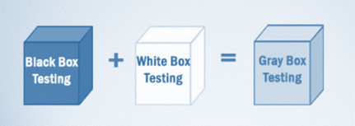
Gray Box Testing is a software testing method, which is a combination of both White Box Testing and Black Box Testing method.
In White Box testing internal behaviour.
In Black Box testing is external behaviour .
In Grey Box Testing internal structure (code) is partially known.

Slide 3
It provides combined benefits of both black box testing and white box testing both
It combines the input of developers as well as testers and improves overall product quality
It reduces the overhead of long process of testing functional and non-functional types
It gives enough free time for a developer to fix defects
Testing is done from the user point of view rather than a designer point of view

Slide 4
Techniques used for Grey box Testing are-
Matrix Testing: This testing technique involves defining all the variables that exist in their programs.
Regression Testing: To check whether the change in the previous version has regressed other aspects of the program in the new version. It will be done by testing strategies like retest all, retest risky use cases, retest within a firewall.
Orthogonal Array Testing or OAT: It provides maximum code coverage with minimum test cases.
Pattern Testing: This testing is performed on the historical data of the previous system defects. Unlike black box testing, gray box testing digs within the code and determines why the failure happened

Slide 5
Steps to perform Grey box Testing are:
Step 1: Identify inputs
Step 2: Identify the outputs
Step 3: Identify the major paths
Step 4: Identify Sub functions
Step 5: Develop inputs for Sub functions
Step 6: Develop outputs for Sub functions
Step 7: Execute test case for Sub functions
Step 8: Verify the correct result for Sub functions
Step 9: Repeat steps 4 & 8 for other Sub functions
Step 10: Repeat steps 7 & 8 for other Sub functions
The test cases for grey box testing may include, GUI related, Security related, Database related, Browser related, Operational system related, etc.

